Slide 1
127 Studio
YOHANES DWI LISTIO
ARRIZKY RAHMAT ALIFIANSYAH
RAFI PRATAMA ADJI
SITI MAISYAROH
FIRDA ROSA OLIVIA MUJIARSO

Slide 2
127 Studio in Numbers
2017
Year established
8
Projects completed successfully
2
Projects running in 2018
750
Highest project value (in million IDR)
5
Initial team members in 127 Studio

Slide 3





Our Specialities

Slide 4
Organization Chart
Rafi P. Adji
Project Manager
Firda Rosa
Web and Database Designer
Yohanes D.L.
Developer
Arrizky R.A.
System Analyst
Siti Maisyaroh
Quality Control

Slide 5
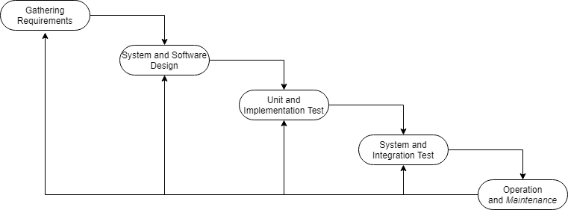
Flow

Slide 6
Project Resources and Timeframe
Timeframe
Project Resources
20 weeks
Details proposed as seen on Project Timeline
Team in Jakarta and Malang.
Roles | Man Days
Project Manager | 87
System Analyst | 30
Quality Control | 66
Developer | 102
Designer | 24

Slide 7
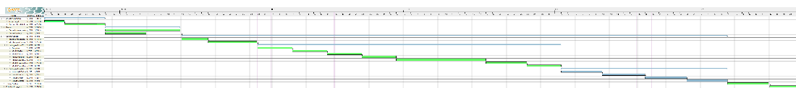
Project Timeline
18 – 26 April 2018 : Gathering Requirements
27 April – 11 May 2018 : Design
14 May – 16 August 2018 : Application Coding
20 – 28 August 2018 : Application Testing
29 August – 5 September 2018 : User Training

Slide 8
Project Budget
No. | Cost | Total Cost
1 | Software Implementation Cost | Rp 113.784.000,00
2 | Overhead Cost | Rp 34.980.000,00
3 | Post Go Live Support (1 month) | Rp 8.580.000,00
TOTAL |  | Rp 157.344.000,00
GRAND TOTAL |  | Rp 173.078.400,00

Slide 9
Software Implementation Cost
Gathering Requirements
No. | Resource | Man | Day | Effort | Man Day | Fixed Man Day | Fixed MD * Days
1 | Project Manager | 1 | 10 | 100% | Rp 420.000,00 | Rp 462.000,00 | Rp 4.620.000,00
2 | System Analyst | 1 | 10 | 100% | Rp 400.000,00 | Rp 440.000,00 | Rp 4.400.000,00
3 | Designer | 1 | 10 | 100% | Rp 320.000,00 | Rp 352.000,00 | Rp 3.520.000,00
4 | Developer | 1 | 10 | 100% | Rp 300.000,00 | Rp 330.000,00 | Rp 3.300.000,00
 |  |  |  |  |  | TOTAL | Rp 15.840.000,00
Development
No. | Resource | Man | Day | Effort | Man Day | Fixed Man Day | Fixed MD * Days
1 | Project Manager | 1 | 66 | 100% | Rp 420.000,00 | Rp 462.000,00 | Rp 30.492.000,00
2 | System Analyst | 1 | 20 | 100% | Rp 400.000,00 | Rp 440.000,00 | Rp 8.800.000,00
3 | Designer | 1 | 14 | 100% | Rp 320.000,00 | Rp 352.000,00 | Rp 4.928.000,00
4 | Developer | 1 | 55 | 100% | Rp 300.000,00 | Rp 330.000,00 | Rp 18.150.000,00
5 | Quality Control | 1 | 66 | 100% | Rp 370.000,00 | Rp 407.000,00 | Rp 26.862.000,00
 |  |  |  |  |  | TOTAL | Rp 89.232.000,00

Slide 10
Deployment (UAT & Training)
No. | Resource | Man | Day | Effort | Man Day | Fixed Man Day | Fixed MD * Days
1 | Project Manager | 1 | 11 | 100% | Rp 420.000,00 | Rp 462.000,00 | Rp 5.082.000,00
2 | Developer | 1 | 11 | 100% | Rp 300.000,00 | Rp 330.000,00 | Rp 3.630.000,00
 |  |  |  |  |  | TOTAL | Rp 8.712.000,00
Maintenance
No. | Resource | Man | Day | Effort | Man Day | Fixed Man Day | Fixed MD * Days
1 | Developer | 1 | 26 | 100% | Rp 300.000,00 | Rp 330.000,00 | Rp 8.580.000,00
 |  |  |  |  |  | TOTAL | Rp 8.580.000,00

Slide 11
Overhead Cost
Gathering Requirements (1st Week)
Gathering Requirements (2nd Week)
UAT
User Training
Man | Days | Plane | PP Client - Hotel | Hotel Room | Hotel | Allowance | Total
4 | 5 | Rp 1.860.000,00 | Rp 600.000,00 | 1 | Rp 2.000.000,00 | Rp 6.000.000,00 | Rp 10.460.000,00
Man | Days | Plane | PP Client - Hotel | Hotel Room | Hotel | Allowance | Total
4 | 5 | Rp 1.860.000,00 | Rp 600.000,00 | 1 | Rp 2.000.000,00 | Rp 6.000.000,00 | Rp 10.460.000,00
Man | Days | Plane | PP Client - Hotel | Hotel Room | Hotel | Allowance | Total
2 | 6 | Rp 930.000,00 | Rp 600.000,00 | 1 | Rp 2.400.000,00 | Rp 3.600.000,00 | Rp 7.530.000,00
Man | Days | Plane | PP Client - Hotel | Hotel Room | Hotel | Allowance | Total
2 | 5 | Rp 930.000,00 | Rp 600.000,00 | 1 | Rp 2.000.000,00 | Rp 3.000.000,00 | Rp 6.530.000,00

